Slide 1
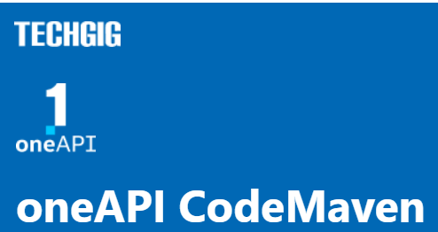
Theme: Predicting Consumer Sentiment
Team Name: Thugs for Bugs
Team Members:
Aramandla Sravanthi - 20211a6605
Dammavalam Sai Saran – 20211a6615
Sravya Nekkanti – 20211a6638
Sevanth Gajula - 20211a6650
Thiyyagura Aditya – 20211a6655

Slide 2
Theme Chosen and Motivation
Anticipating consumer sentiment is of utmost importance for businesses as it can significantly impact essential business outcomes like sales, customer retention, and brand image.
Accurately predicting consumer sentiment enables businesses to make well-informed decisions that enhance their profitability.
Therefore, selecting this theme for a competition can highlight the critical role played by sentiment analysis and its potential impact on the business ecosystem and society at large.

Slide 3
Proposed Tech Architecture
Tech Stack
The solution employs a machine learning tech stack that includes various libraries, frameworks, and algorithms to analyze social media activity and predict consumer sentiment. The solution is designed to be scalable and efficient, capable of processing large amounts of data quickly and accurately. The following are the key components of the machine learning tech stack:
Pandas: A data manipulation library used to load and preprocess large datasets of social media activity.
NumPy: A fundamental library for scientific computing in Python that provides support for large, multi-dimensional arrays and matrices.
Scikit-learn: A popular machine learning library that provides a wide range of algorithms for classification, regression, clustering, and more. The Scikit-learn library is used to train and evaluate the machine learning model.

Slide 4
Proposed Tech Architecture
Tech Stack
Natural Language Toolkit (NLTK): A leading platform for building Python programs to work with human language data. NLTK provides tools for tokenization, stemming, lemmatization, and more, which are used in the preprocessing of the text data.
daal4py: A library that provides Python bindings for Intel's Data Analytics Acceleration Library (Intel DAAL), used to efficiently train Ridge Regression and Random Forest Regressor models.
Ridge Regression, Random Forest Regressor, and Stacking Regressor: These machine learning algorithms are used to predict consumer sentiment towards different types of content based on social media activity. The Stacking Regressor combines the predictions of multiple base estimators, including Ridge Regression and Random Forest Regressor, to improve the accuracy of the predictions.

Slide 5
Proposed Tech Architecture
Tech Stack
daal4py is a library that provides Python bindings for Intel's Data Analytics Acceleration Library (Intel DAAL). Intel DAAL is a powerful library for high-performance data analytics that provides a wide range of algorithms for tasks such as classification, regression, clustering, and more. With daal4py, optimized algorithms of Intel DAAL can be used from within Python applications, making it easier to achieve high performance on Intel architecture.
daal4py is designed to be user-friendly, with a simple API that makes it easy to get started with Intel DAAL in Python. Pythonic interfaces to Intel DAAL's algorithms are provided by daal4py, so that Python developers can take advantage of Intel DAAL's performance benefits without needing to learn a new programming language or complex API.
A number of performance optimizations are also provided by daal4py to help Python developers achieve the best possible performance on Intel architecture. For example, parallelism in Intel DAAL algorithms can be enabled to take advantage of multicore CPUs through support for Intel's Threading Building Blocks (TBB) library.

Slide 6
Proposed Tech Architecture
Tech Stack
daal4py is used in this project to train the Ridge Regression and Random Forest Regressor models efficiently. By using daal4py's optimized algorithms and support for Intel MKL, high performance can be achieved on Intel architecture, enabling large amounts of social media data to be processed quickly and accurately.
React.js for the frontend and Django f the backend were used to build the a fully functional and responsive web application.
Link: https://sentimentai.onrender.com/

Slide 7
Proposed Tech Architecture
Flow of the Project
Load and analyze the data
Load the train and test datasets using Pandas.
Analyze the data and understand the structure and features.
Data preprocessing
Handle missing values (if any).
Convert the timestamp to a suitable format.
Pre-process text data (Title and Headline columns) by tokenizing, removing stopwords, and applying stemming/lemmatization.
Feature engineering
Create new features from text data, such as word count, sentiment polarity, and subjectivity.
Normalize the numerical features using feature scaling techniques like MinMaxScaler or StandardScaler.

Slide 8
Proposed Tech Architecture
Flow of the Project
Train-test split
Split the train dataset into train and test (or validation) sets for model evaluation.
Model building with scikit-learn
Import Ridge Regression, Random Forest Regressor, and Stacking Regressor from Scikit-learn.
Train Ridge Regression, Random Forest Regressor, and Stacking Regressor models on the train set.
Validate their performance using the test (or validation) set.
Model optimization
Tune hyperparameters for both Ridge Regression and Random Forest Regressor models to improve performance.
Consider ensemble methods or stacking both models for better predictions.

Slide 9
Proposed Tech Architecture
Flow of the Project
Web Application
Developing a fully responsive web appliction to see the results.

Slide 10
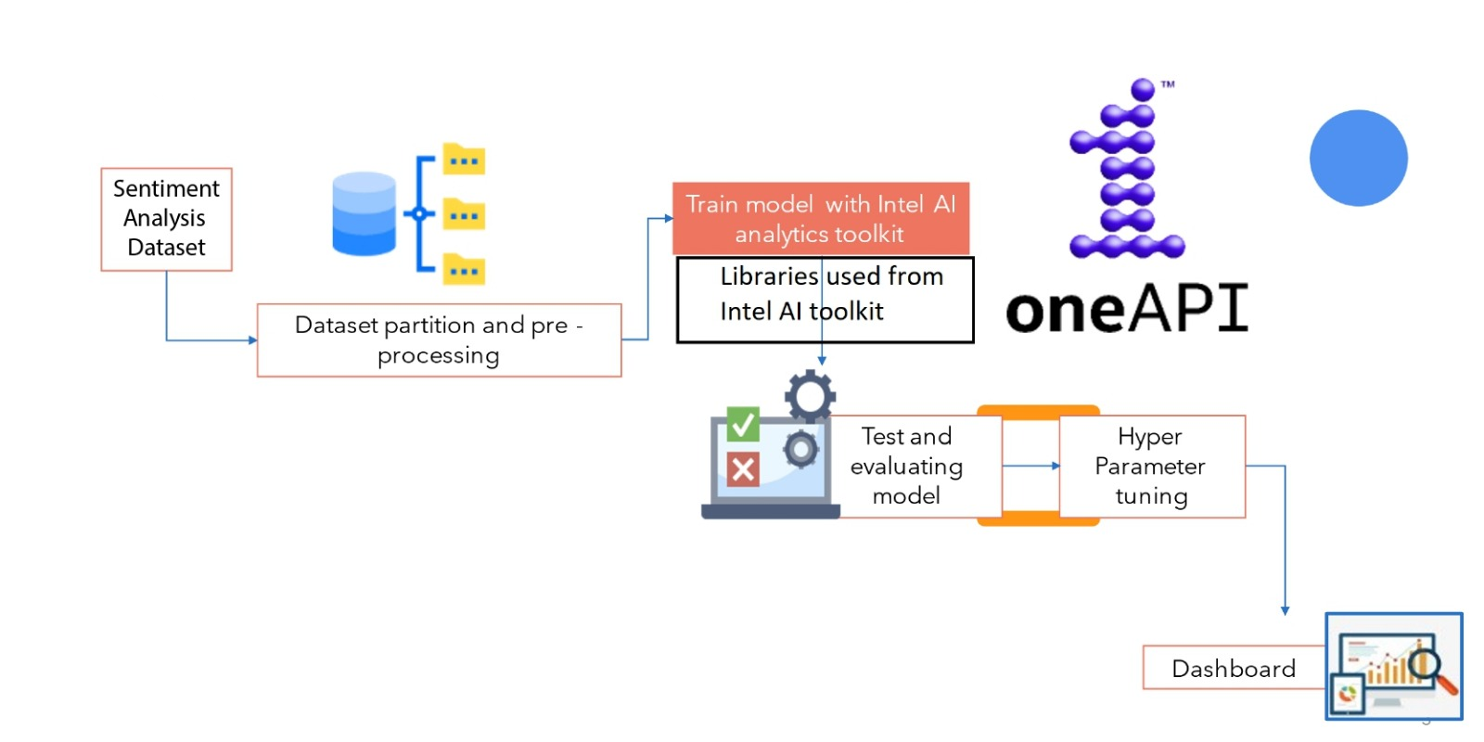
Tech Architecture

Slide 11
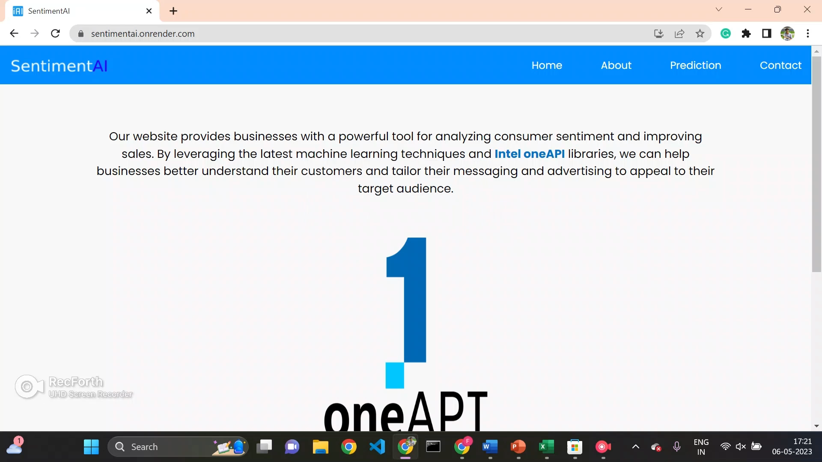
Demo Video
Video Link: https://drive.google.com/file/d/1_uwxwCcmbx36ldlnhB5AQMkQEOYstqoA/view?usp=sharing
Website Link: https://sentimentai.onrender.com/

Slide 12
GitHub Repository Link
Link: https://github.com/Saran3072/CodeMaven_Intel_OneAPI

Slide 13
Results Summary
Output File: https://drive.google.com/file/d/1aUdGiOIiX_nds-V96acNWx7f2tv7Cxkt/view?usp=sharing
Mean Squared Error for SentimentTitle | Mean Squared Error for SentimentHeading
0.016276327823882497 | 0.01769554591714139
*The metrics given above are for the validation data.
Successfully performed the sentiment analysis for the given test data.

